Slide 1
Chapter 13:
Introduction to Classes

Slide 2
13.10
Overloading Constructors

Slide 3
Overloading Constructors
A class can have more than one constructor
Overloaded constructors in a class must have different parameter lists:
  Rectangle();
  Rectangle(double);
  Rectangle(double, double);

Slide 4
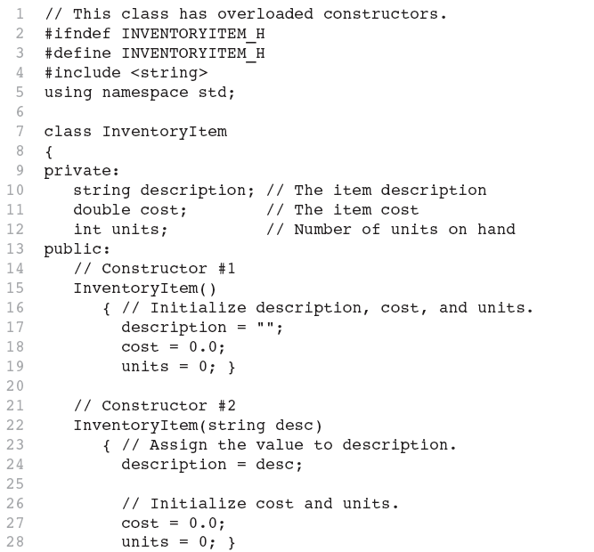
Continues...

Slide 5
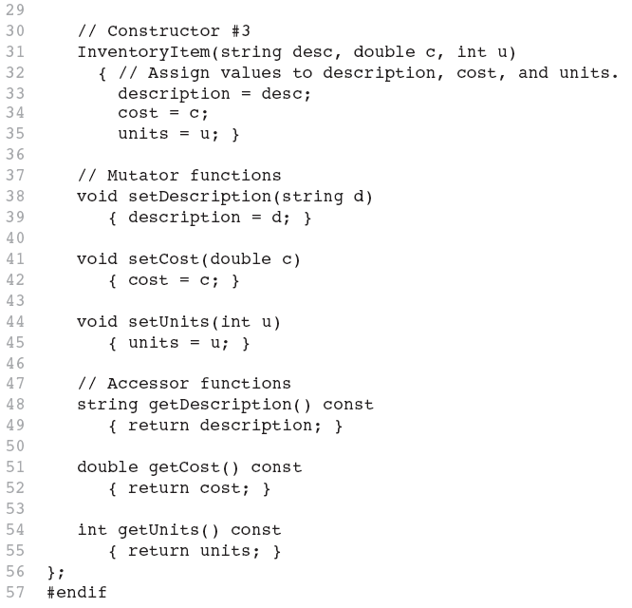

Slide 6
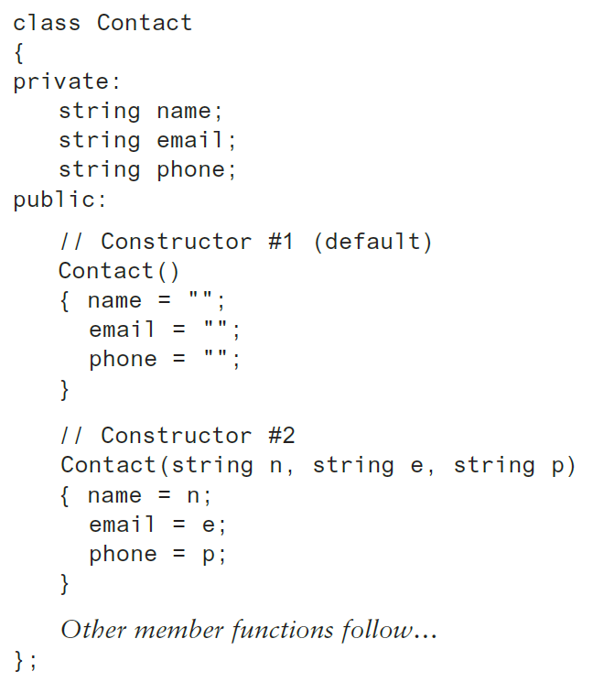
Constructor Delegation
Sometimes a class will have multiple constructors that perform a similar set of steps. For example, look at the following Contact class:

Slide 7
Constructor Delegation
Both constructors perform a similar operation: They assign values to the name, email, and phone member variables.
The default constructor assigns empty strings to the members, and the parameterized constructor assigns specified values to the members.

Slide 8
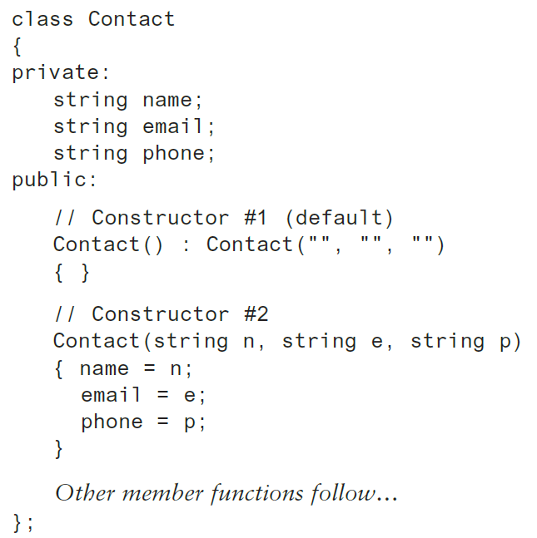
Constructor Delegation
In C++ 11, it is possible for one constructor to call another constructor in the same class.
This is known as constructor delegation.

Slide 9
Only One Default Constructor and One Destructor
Do not provide more than one default constructor for a class: one that takes no arguments and one that has default arguments for all parameters
  Square();
  Square(int = 0); // will not compile
Since a destructor takes no arguments, there can only be one destructor for a class

Slide 10
Member Function Overloading
Non-constructor member functions can also be overloaded:
  void setCost(double);
  void setCost(char *);
Must have unique parameter lists as for constructors

Slide 11
3.11
Using Private Member Functions

Slide 12
Using Private Member Functions
A private member function can only be called by another member function
It is used for internal processing by the class, not for use outside of the class
See the createDescription function in ContactInfo.h (Version 2)

Slide 13
13.12
Arrays of Objects

Slide 14
Arrays of Objects
Objects can be the elements of an array:
  InventoryItem inventory[40];
Default constructor for object is used when array is defined

Slide 15
Arrays of Objects
Must use initializer list to invoke constructor that takes arguments:
  InventoryItem inventory[3] =
  { "Hammer", "Wrench", "Pliers" };

Slide 16

Arrays of Objects
If the constructor requires more than one argument, the initializer must take the form of a function call:

Slide 17

Arrays of Objects
It isn't necessary to call the same constructor for each object in an array:

Slide 18
Accessing Objects in an Array
Objects in an array are referenced using subscripts
Member functions are referenced using dot notation:
  inventory[2].setUnits(30);
  cout << inventory[2].getUnits();

Slide 19
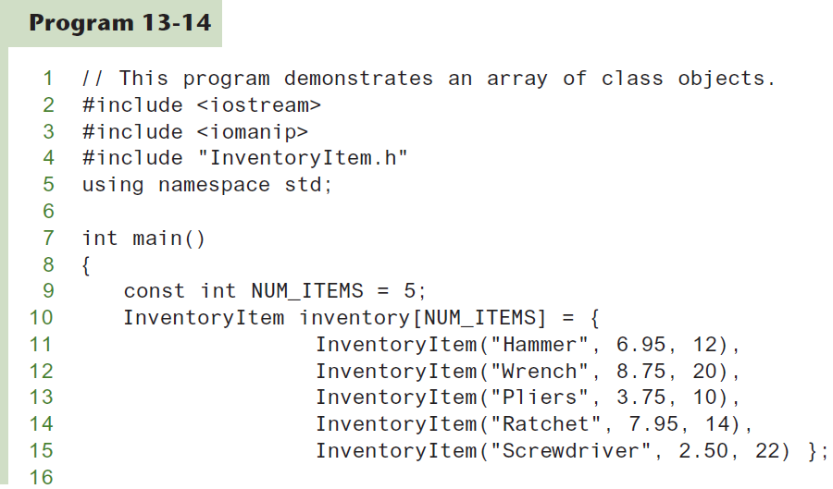

Slide 20
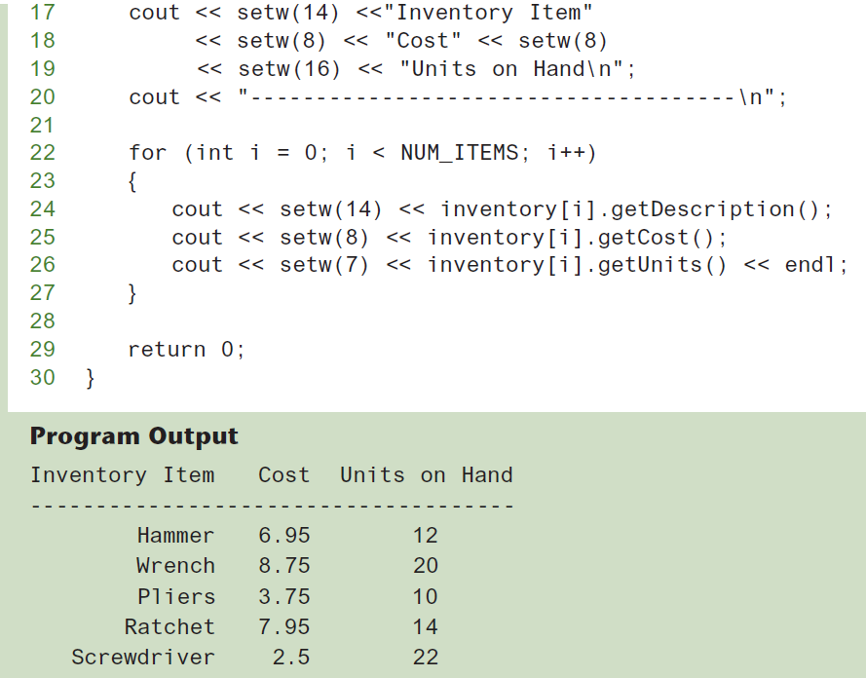
Program 13-14 (Continued)

Slide 21
13.16
The Unified Modeling Language

Slide 22
The Unified Modeling Language
UML stands for Unified Modeling Language.
The UML provides a set of standard diagrams for graphically depicting object-oriented systems

Slide 23
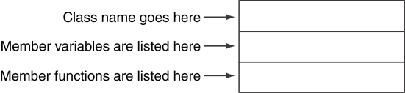
UML Class Diagram
A UML diagram for a class has three main sections.

Slide 24
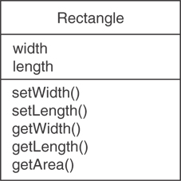
Example: A Rectangle Class
class Rectangle
{
private:
double width;
double length;
public:
bool setWidth(double);
bool setLength(double);
double getWidth() const;
double getLength() const;
double getArea() const;
};

Slide 25
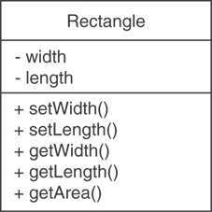
UML Access Specification Notation
In UML you indicate a private member with a minus (-) and a public member with a plus(+).
These member variables are private.
These member functions are public.

Slide 26
UML Data Type Notation
To indicate the data type of a member variable, place a colon followed by the name of the data type after the name of the variable.
- width : double
- length : double

Slide 27
UML Parameter Type Notation
To indicate the data type of a function’s parameter variable, place a colon followed by the name of the data type after the name of the variable.
+ setWidth(w : double)

Slide 28
UML Function Return Type Notation
To indicate the data type of a function’s return value, place a colon followed by the name of the data type after the function’s parameter list.
+ setWidth(w : double) : void

Slide 29
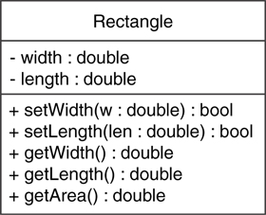
The Rectangle Class

Slide 30
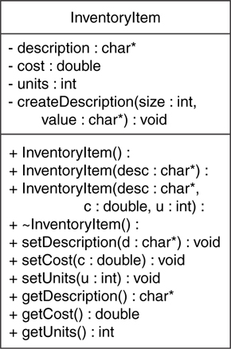
Showing Constructors and Destructors
No return type listed for constructors or destructors
Constructors
Destructor

